Slide 1
Servo-PAY APP
Rinat OZ 208935791
Daniel gimplman 312211154

Slide 2
MAIN IDEA:
Location-based app that recommends small businesses and service providers while maintaining ease of use, division of services provided by profession, filtering by rating or location.
Our app allows a client-side interface , as well as a business-side interface.

Slide 3
OUR VISION:
Our project aims to promote service giver who advertise themselves mainly over social media, and from the other side let the consumers to easily find a recommended, nearby service giver for the matter the consumer was looking for. Our main goal is to give the costumer a good service while advertising service givers.

Slide 4
GOALS:
• Satisfy Service providers – Our project lets service providers get consumers that they are interested in.
• Satisfy the Consumers – The project offers the costumers easy and intuitive way to look for a specific service provider.

Slide 5
FEATURES:
Features included in the release are:
• Dedicated advertising platform for the service provider.
• Intuitive user interface.
• Search engine dedicated to find a service giver for the consumer.

Slide 6
SERVO-APP
Client-Side
Business-Side

Slide 7
CLIENT-SIDE:
The option to search for service giver by topic, category and in more advanced stages filtering searches for better accuracy.

Slide 8
BUSINESS-SIDE:
The project will let the service provider to create a profile page where he will provide info about his service including general description, videos and more information to the provider desire.

Slide 9
DESIGN:
The UI design is going to implement a “feed” design following the lines of social media outlets.
Each service provider has a main profile that is essentially pictures that shows the quality of service, and what he can do/make/perform/etc.
There are reference to business page links, phone, location, etc.

Slide 10
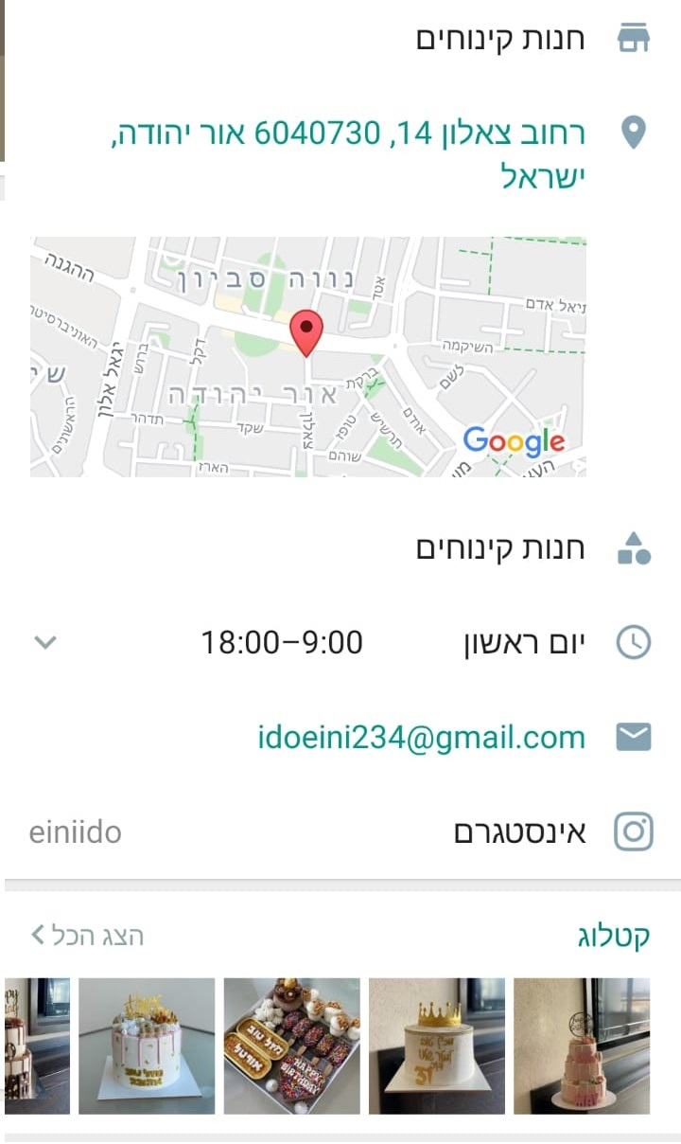
PROFILE-VIEW:
Name\Tag
Address
Provider Location
Opening Hours
Contact information
Business Card
Catalog

Slide 11
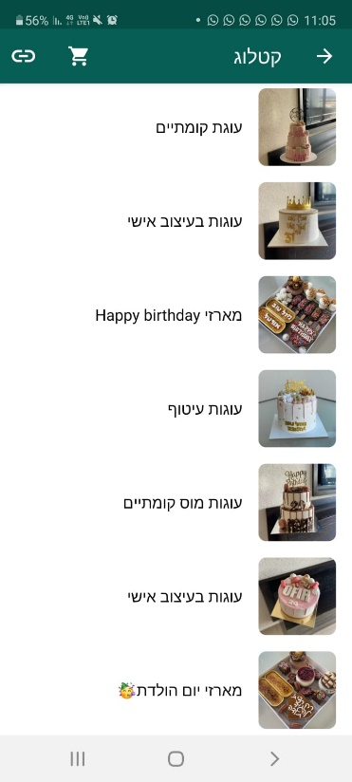
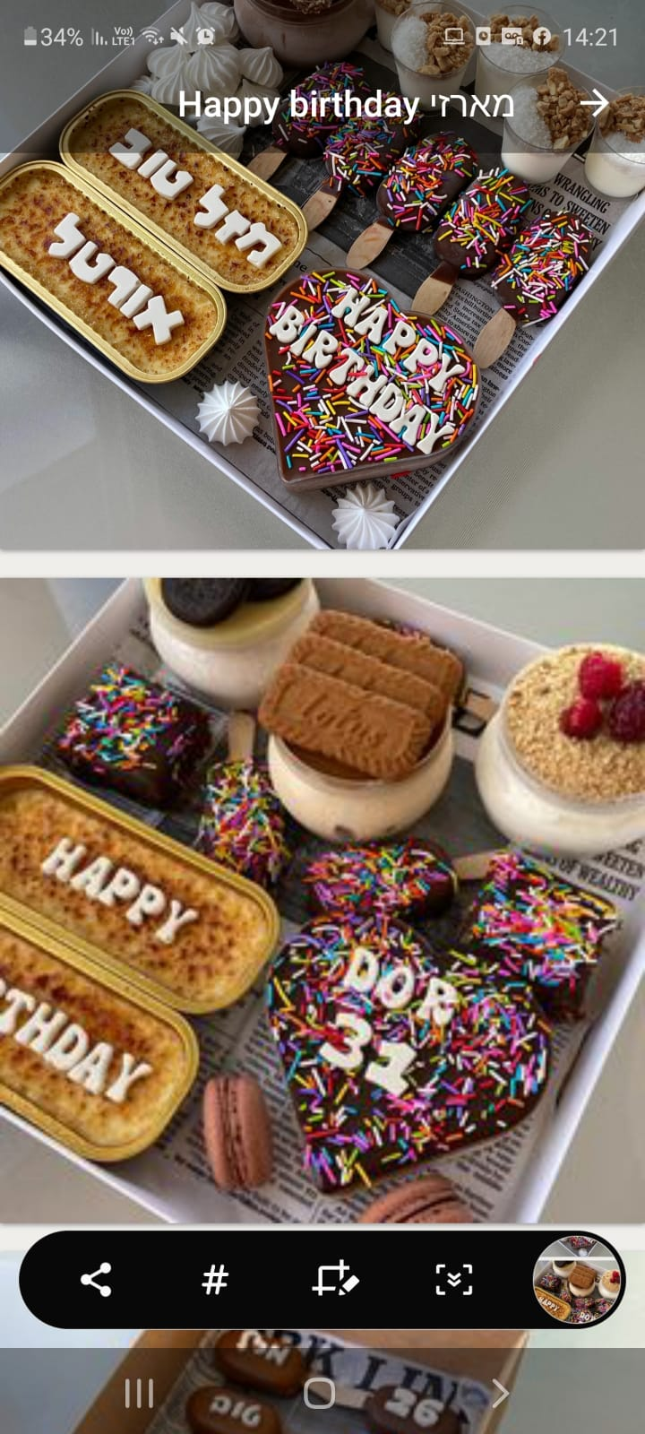
CATALOG:

Slide 12
Application Workflow:
A Costumer in need of a service
Signing into Servo-app
Selecting the desired service
Planned Preferences:
Features of the service that are important to the customer.
Examples:
location , prices , ranks , quality, years of experience
Select preferences
Get results according to the best match

